Slide 1
DESIGN and ANALYSIS of ALGORITHMS HIMANSHU SRIVASTAVA CSE 2nd Year Roll no. : 181220031

Slide 2
SINGLE SOURCE SHORTEST PATH
BELLMAN FORD ALGORITHM

Slide 3
BELLMAN FORD ALGORITHM
Bellman Ford algorithm helps us find the shortest path from a vertex to all other vertices of a weighted graph.
It is similar to Dijkstra's algorithm but it can work with graphs in which edges can have negative weights.

Slide 4
Why negative edges ?
Negative weight edges might seem useless at first
but they can explain a lot of phenomena like : -
Cash flow
Heat released
Heat absorbed

Slide 5
Why negative edges ?
For instance, if there are different ways to reach from one chemical A to another chemical B, each method will have sub-reactions involving both heat dissipation and absorption.
If we want to find the set of reactions where minimum energy is required, then we will need to be able to factor in the heat absorption as negative weights and heat dissipation as positive weights.

Slide 6
How does BELLMAN FORD works
Bellman Ford algorithm works by overestimating the length of the path from the starting vertex to all other vertices.
Then it iteratively relaxes those estimates by finding new paths that are shorter than the previously overestimated paths.

Slide 7
How does BELLMAN FORD works
If the directed weighted graph has number of vertices = |V| , then the maximum number of iterations required for this algorithm is L_{max} .
L_{max} = |V| - 1 .

Slide 8
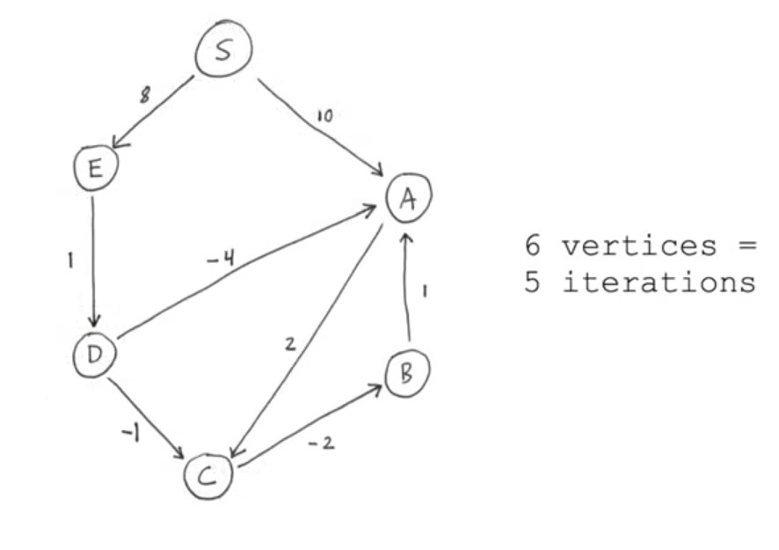
Example of Bellman Ford
Find the shortest path from vertex S all other vertices.

Slide 9
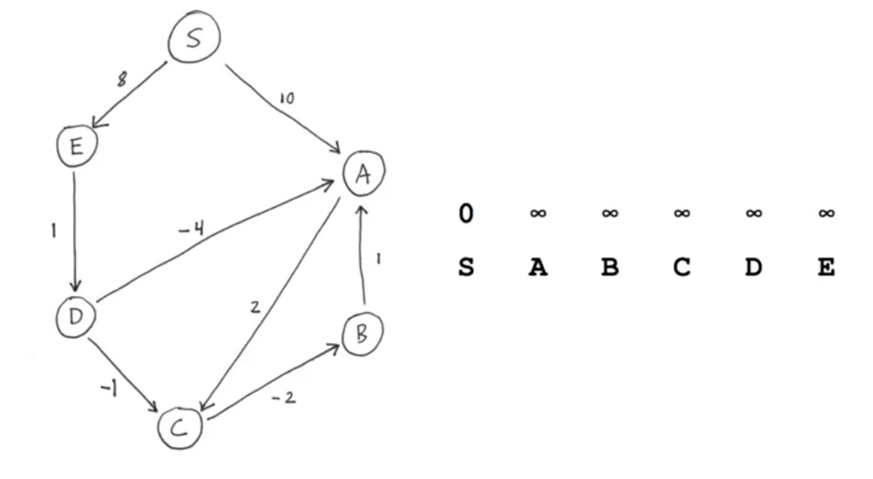
Example of Bellman Ford

Slide 10
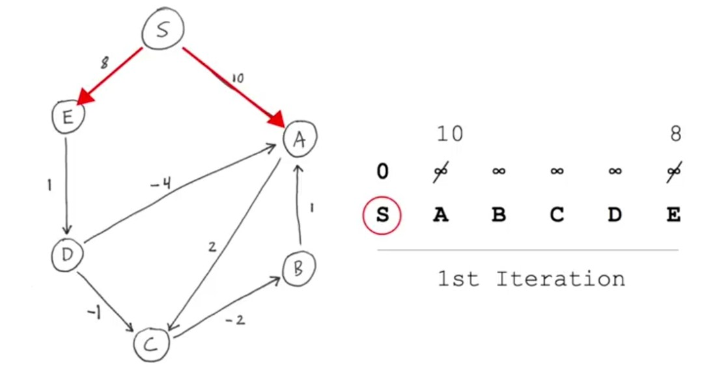
Example of Bellman Ford

Slide 11
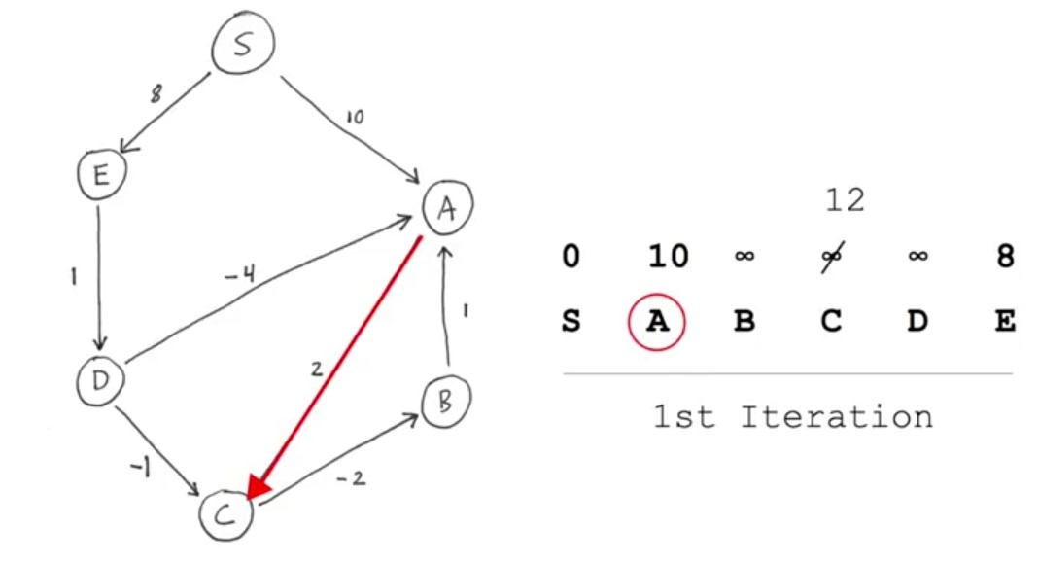
Example of Bellman Ford

Slide 12
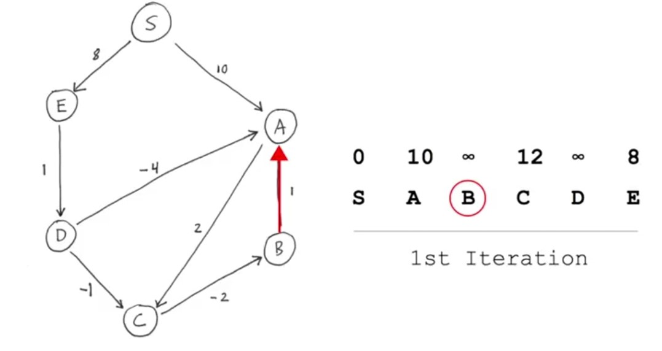
Example of Bellman Ford

Slide 13
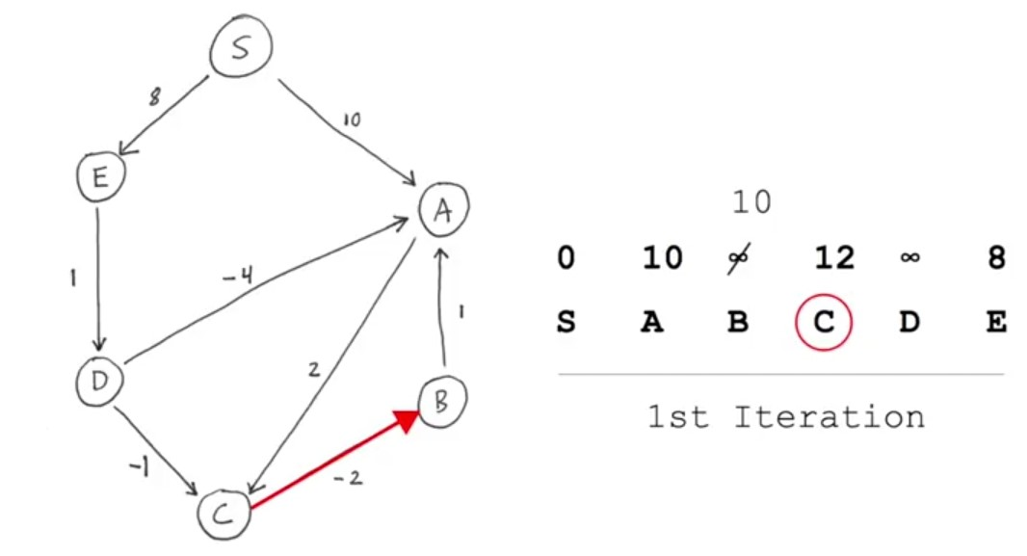
Example of Bellman Ford

Slide 14
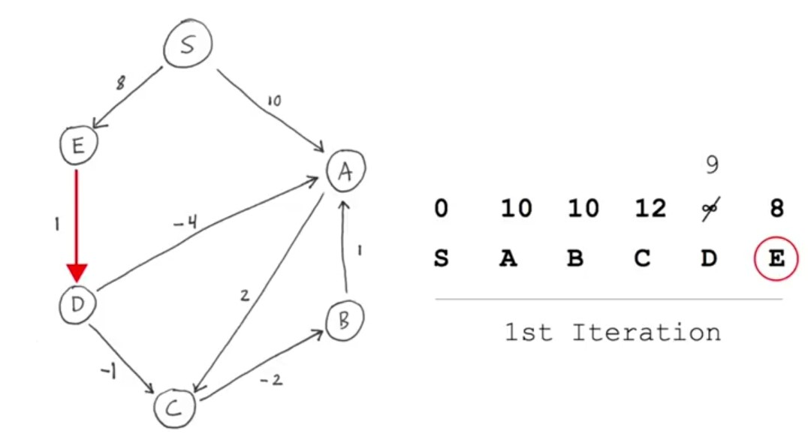
Example of Bellman Ford

Slide 15
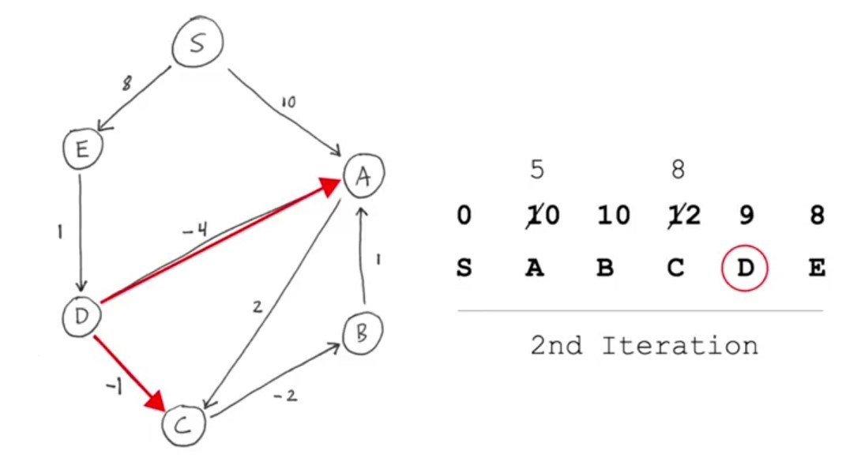
Example of Bellman Ford

Slide 16
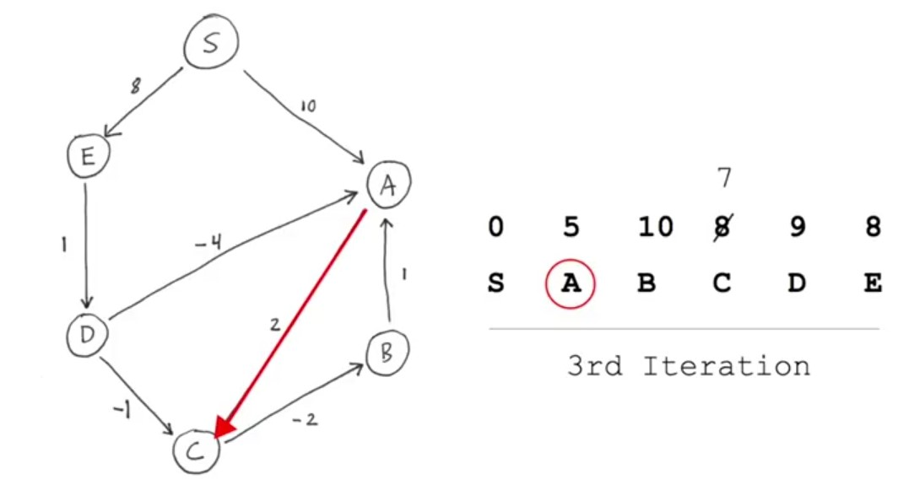
Example of Bellman Ford

Slide 17
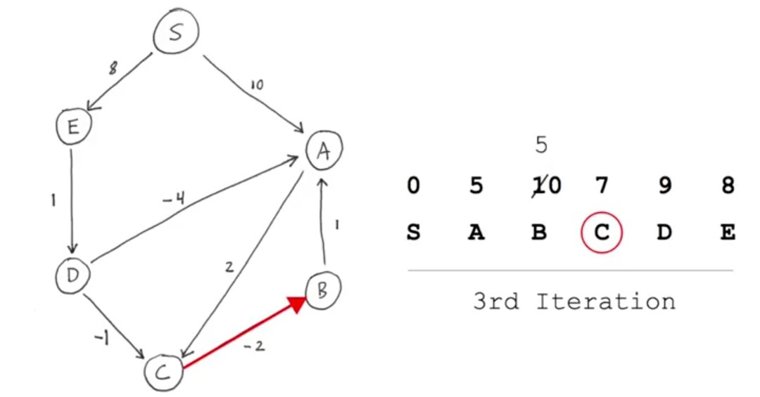
Example of Bellman Ford

Slide 18
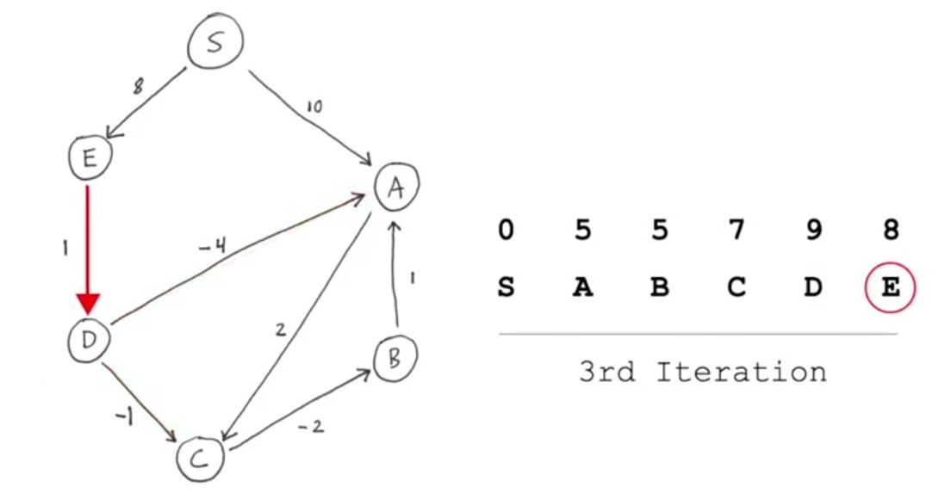
Example of Bellman Ford

Slide 19
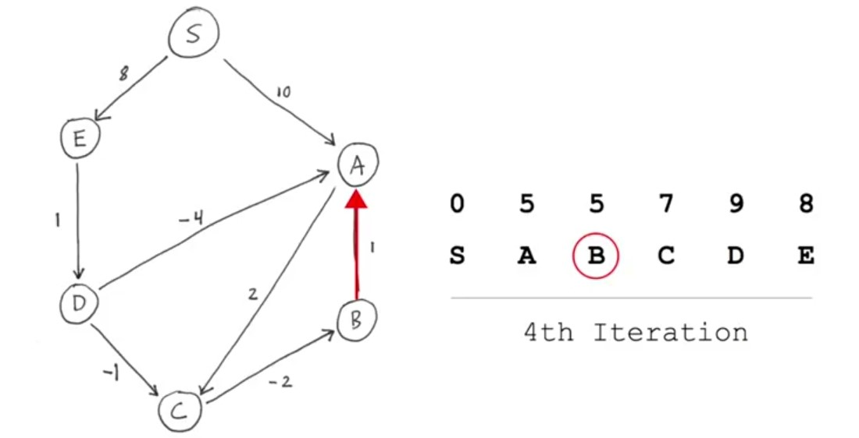
Example of Bellman Ford

Slide 20
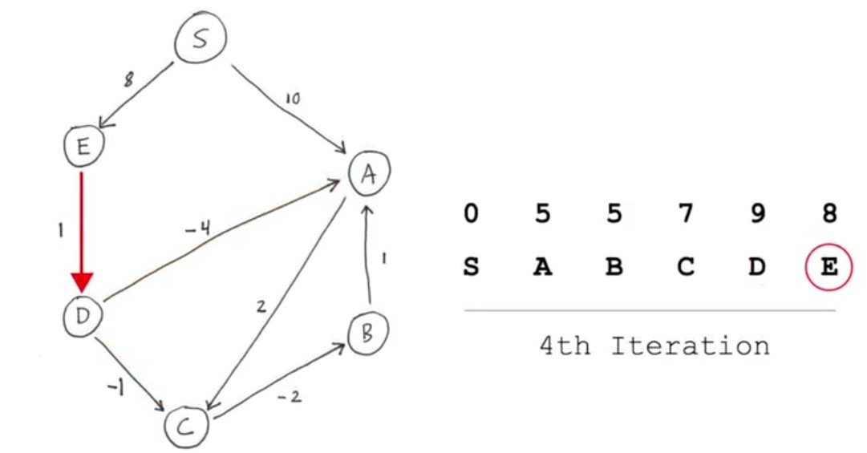
Example of Bellman Ford

Slide 21
Example of Bellman Ford

Slide 22
Example of Bellman Ford
As in the 4th iteration no change has taken place.
So, it is the final answer.
At most |V|-1 iterations are required for this algorithm to find the shortest to all other vertices from the given vertex ‘S’.

Slide 23
BELLMAN FORD ALGORITHM
If Bellman ford algorithm is used in graph
G = (V , E) to find the shortest distance from a vertex to all other vertex , then
Time complexity = O( |V|*|E| )

